Slide 1

ATIEL/ATC Generic Exposure Scenarios
ENES 5 Breakout Session
ATIEL represented by Alison Margary and Joy Worden (Shell)
ATC represented by Sara Brennan (Afton Chemical)

Slide 2

Contents
Overview of the ATIEL/ATC GES mixtures approach (Alison)
Example 1: Lubricant additive formulation (ATC) (Sara)
Example 2: Lubricant end use formulation (ATIEL) (Alison and Joy)
Conclusions and discussion (Sara – all)
21/11/13 ATIEL/ATC Generic Exposure Scenario Approach

Slide 3
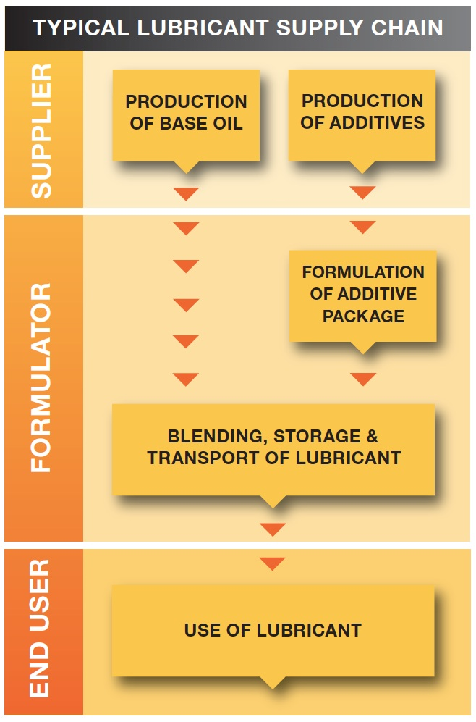
Features of the Lubricants’ Supply Chain
Well-defined and structured sector
Limited number of manufacturers and major formulators
Large number of smaller formulators
Formulations oriented towards specific end uses
Stable formulations during life cycle
Formulators sell directly to distributors and end-users
Characteristics that enable generic-based solutions for the sector to be scoped, trialled and refined
21/11/13 ATIEL/ATC Generic Exposure Scenario Approach

Slide 4
How were GESs developed ?
Mapping of product types to typical uses
Assignment of adequate use descriptors
(SUs, PCs, PROCs and ERCs)
Grouping by main conditions of use
  Open vs. closed processes,
  High temperature, high energy processes
  Other risk factors (aerosol formation)
  Exposure potential (dermal, inhalation, ingestion)
  Typical Operational Conditions and Risk Management Measures
Results:
  Use and application table
  DUCC Table
21/11/13 ATIEL/ATC Generic Exposure Scenario Approach

Slide 5
ATIEL/ATC Use Groups
ATIEL/ ATC Use Group | Description of Use | Sectors Covered
A | Formulation of lubricant additives, lubricants and greases. Includes material transfers, mixing, large and small scale packing, sampling, maintenance and associated laboratory activities. | Industrial
B | General use of lubricants and greases in vehicles or machinery. Includes filling and draining of containers and enclosed machinery (including engines) | Industrial, Professional, Consumer
C | Use in open systems. Application of lubricant to work pieces or equipment by dipping, brushing or spraying (without exposure to heat), e.g. mould releases, corrosion protection, slideways | Industrial, Professional, Consumer
D | Use of lubricants in open high temperature processes, e.g. quenching fluids, glass release agents | Industrial
E | Handling and dilution of metalworking fluid concentrates | Industrial
F | Use of lubricants in high energy open processes, e.g. in high speed machinery such as metal rolling / forming or metalworking fluids for machining and grinding | Industrial, Professional
21/11/13 ATIEL/ATC Generic Exposure Scenario Approach

Slide 6
ATIEL/ATC Use and Application Table
D O C U M E N T 2
21/11/13 ATIEL/ATC Generic Exposure Scenario Approach

Slide 7
ATIEL/ATC Use Groups: DUCC-Table
D O C U M E N T 3
21/11/13 ATIEL/ATC Generic Exposure Scenario Approach

Slide 8
Human Health Contributing Scenarios
Typical compositions and hazard classifications of products identified for each ATIEL Use Group
Boundary conditions described using control banding approaches and key Risk Determining Substances as the reference point
  e.g. concentration of the relevant hazardous substances, definition of exposure reference values
CSAs conducted for each ATIEL Use Group supported by typical OCs and RMMs mapped in the DUCC table and Boundary Conditions
  using ECETOC TRA for exposure estimates and CEFIC Worker CSA Template
GES narratives developed from CSAs using standard phrases
21/11/13 ATIEL/ATC Generic Exposure Scenario Approach

Slide 9
Environmental Contributing Scenarios
Information gathered from Members:
  Potential Risk Determining Substances (RDS)
  Typical use rates
  Exposure (Emission) data
  Typical OCs and RMMs used
Obtained volume data for lubricants’ supply chain
Developed SpERCs (Specific Environmental Release Categories) for industrial and professional use groups
21/11/13 ATIEL/ATC Generic Exposure Scenario Approach

Slide 10
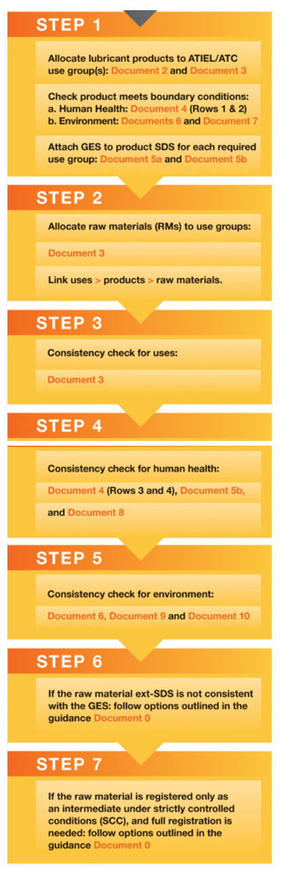
Attaching GESs and checking raw
materials - overview of process
Step 1:
  Allocate lubricant products to ATIEL-ATC use group(s)
  Check that product meets product boundary conditions
  Attach GES to product SDS for each required use group
Step 2:
  Allocate raw materials (RMs) to use groups
  Link uses ↔ products ↔ raw materials
Step 3:
  Verification check for uses
Step 4
  Verification check for human health
Step 5
  Verification check for environment
Step 6
  Options if raw material ext-SDS is not consistent with the GES
Step 7
  Actions if RM registered as Intermediate under SCC, but full
  Registration required
Tested with large/SME formulators - positive
Consistency checks between raw material ext-SDS and GESs
21/11/13 A Generic Exposure Scenario Approach

Slide 11

http://atiel.org/
21/11/13 ATIEL/ATC Generic Exposure Scenario Approach

Slide 12
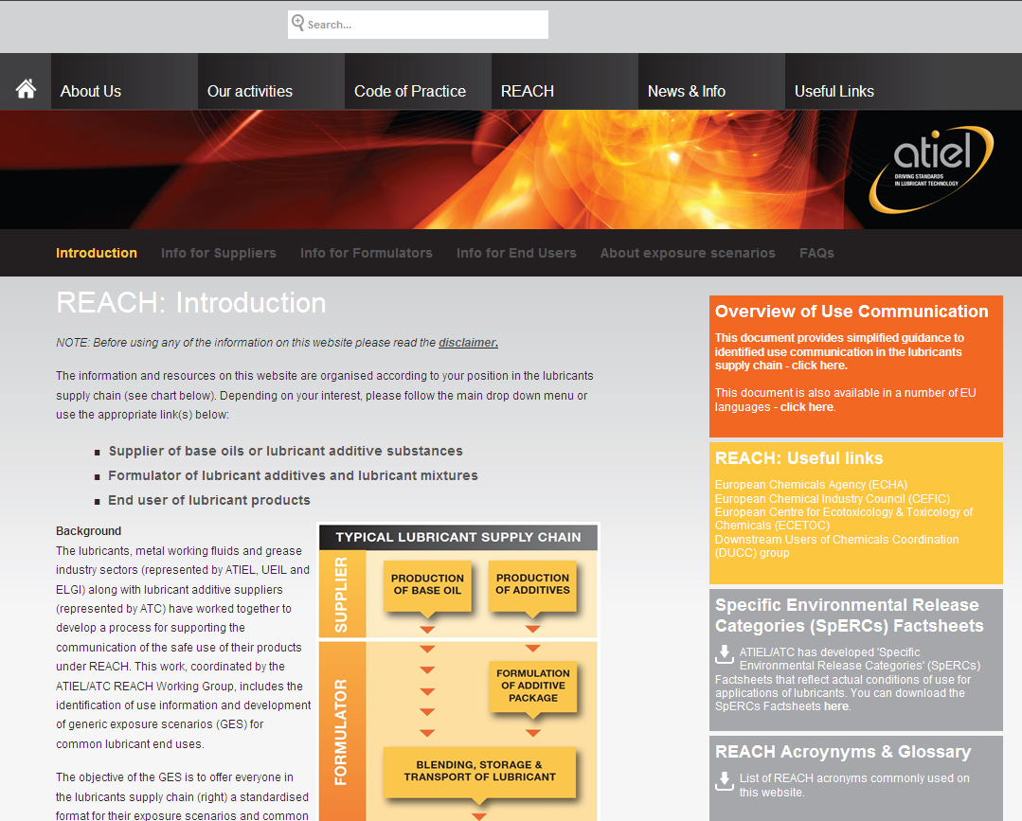
21/11/13 ATIEL/ATC Generic Exposure Scenario Approach

Slide 13

21/11/13 ATIEL/ATC Generic Exposure Scenario Approach

Slide 14

ATC Demonstration of
GES Example 1
Safe use information for mixtures.
ATIEL-ATC GES Approach
21/11/13 ATIEL/ATC Generic Exposure Scenario Approach

Slide 15
Break-out Session
Scope: How to define and communicate information on safe use of (substances in) mixtures: discussion on the possible methodologies.
Objective: To demonstrate the process we use to compile GESs as well as the practical problems encountered with process
Reference documents:
  Example completed GES
  Document 1: ATIEL-ATC GES Process Flow Chart
  Document 4: ATIEL-ATC Health Boundary Conditions Matric
  Document 7: ATIEL-ATC Environmental GES Values Table
21/11/13 ATIEL/ATC Generic Exposure Scenario Approach

Slide 16
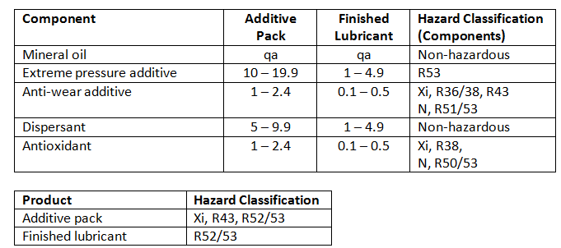
Worked Example
The first example that will be demonstrated today is that of an additive pack. This is the GES process that the formulator of the additive pack goes through.
Typical “generic” formulation
Classification of the example additive pack and also of the finished lubricant
21/11/13 ATIEL/ATC Generic Exposure Scenario Approach

Slide 17


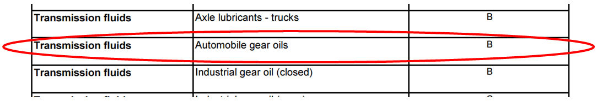
Introduction and
Application
All documentation is available freely on the ATIEL website: www.ATIEL.org.
Start by reading Document 0 (background reading) and
then working through the process flow in Document 1.
When we work through the example we can see that it is
classified for both Human Health and the Environment.
For the formulation example it will be use group A,
  for the professional use example that is not talked through but available as a completed GES example we use document 2 to look up the Group.
The application can be found by referring to the table in Document 2.
21/11/13 ATIEL/ATC Generic Exposure Scenario Approach

Slide 18
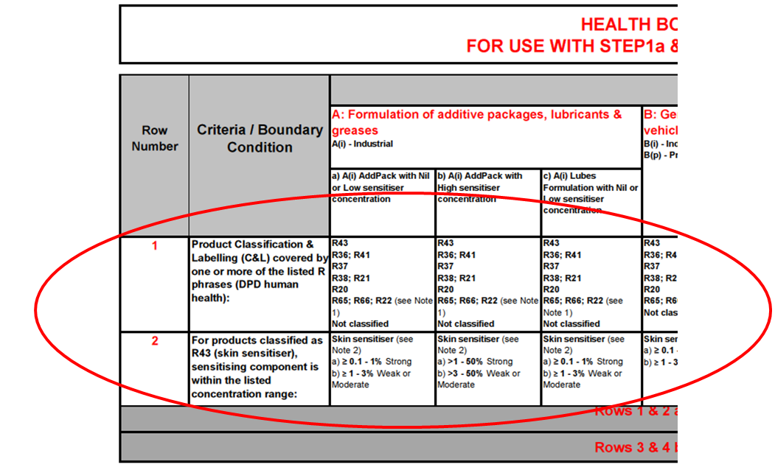
Use and Human Health
We now need to select the appropriate use group from the DUCC table in Document 3. For this example we will select Group A(i) Industrial formulation of lubricant additives and lubricants.
Document 4. is where we check the boundary conditions to see if the Human Health section of the GES is relevant to the mixture.
Our example gear additive package falls within the conditions
of the boundary matrix of the GES (rows 1 and 2).
Rows 3 and 4 are for checking the
health related information received
in a raw material ext-SDS is consistent
with the health Component of
the GES(s).
21/11/13 ATIEL/ATC Generic Exposure Scenario Approach

Slide 19
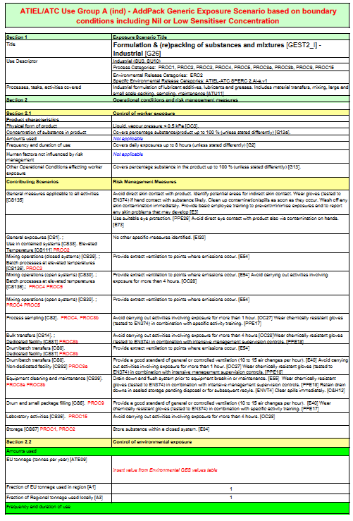
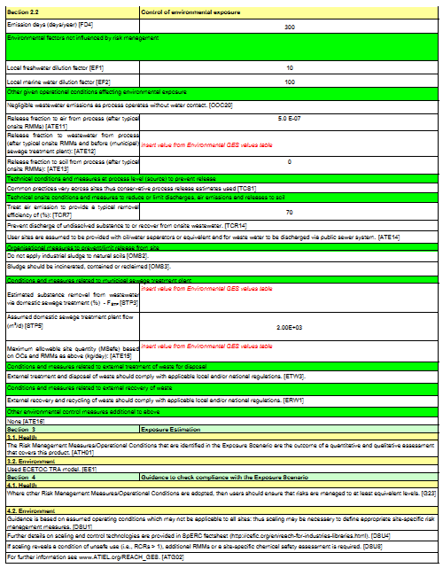
GES Groups
Document 5a (Group A) and Document 5b (Groups B-F) contain the GES narratives by groups.
For our example we need 5a as we are only concerned with Group A. The GES relevant to our example is A(i) AddPack, Nil-Low Sensitiser.
The GES template is just two pages long which
makes it user friendly.
We have completed the Human Health component
now and so to complete our GES we now need to
look at the Environment.
21/11/13 ATIEL/ATC Generic Exposure Scenario Approach

Slide 20
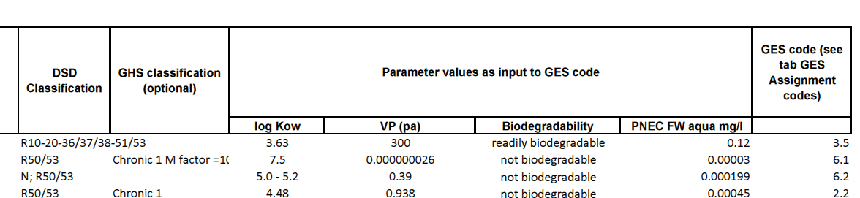
Environment
Document 6 provides the parameter values for a range of risk determining substances (RDSs) applied to pre-assign the appropriate GES code. If the product contains more than one listed RDS the “worst case” component should be assigned as the RDS to use for the GES.
For our example 2,6-Di-tertiary butylphenol is the RDS.
The table provides the GES code (2.2) plus the log Kow, VP, PNECfw(aq) and biodegradability upon which the code is based.
In the event that the environmental RDS component is not listed the required GES Code can be found in Document 7.
  You will need to independently determine the above values (log Kow, VP,
  PNECfw(aq) and biodegradability for your unlisted RDS substance.
21/11/13 ATIEL/ATC Generic Exposure Scenario Approach

Slide 21
Environment
When the correct GES Code has been identified, also use Document 7 to identify the following:
The parameters in the table are found by looking at the GES code we determined for each section. These are the values for GES 2.2.
The values highlighted are the values we need to input into our GES.
    If actual treat rate is known some values may be scaled accordingly.
GES | Parameter | Value | Units | Notes
A_{(i)} | Release fraction (air) | 5.00E-07
 | Release fraction (water) | 2.00E-10 |  | Default value (based on 20% treat rate)
 | STP removal | 0.09 | %
 | Msafe RDS | 66785 | kg/day
 | Msafe product | 333925 | kg/day | Default value (based on 20% treat rate)
 | Treat rate (actual) | 0.5 | %
 | Validity limit | 70 | % | Maximum treat rate
 | REF EU tonnage (substance) | 1.00E+04
 | REF emission days | 300 | days/year
21/11/13 ATIEL/ATC Generic Exposure Scenario Approach

Slide 22
Verification Check
The GES can now be added to the extended-SDS
On receipt of component ES, carry out the verification check that the GES remains valid
☑
21/11/13 ATIEL/ATC Generic Exposure Scenario Approach

Slide 23
ATIEL Demonstration of
GES Example 2
Safe use information for mixtures.
ATIEL-ATC GES Approach
21/11/13 ATIEL/ATC Generic Exposure Scenario Approach

Slide 24
Example 2 - GES for finished
lubricant product
Synthetic Hydraulic Oil
Classified R20 R52/53
Use group B – use of lubricants and greases in vehicles and machinery (closed systems) - Industrial
Information on classified components:
21/11/13 ATIEL/ATC Generic Exposure Scenario Approach

Slide 25
Example 2 - GES for finished
lubricant product
Action 1: Assign relevant GES to
products, if appropriate
Action 2: Verify contents of the GES
By checking against the incoming raw
Material/component ES details
21/11/13 ATIEL/ATC Generic Exposure Scenario Approach

Slide 26
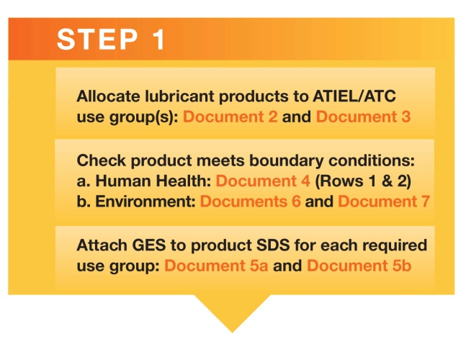
Example 2 - GES for finished
lubricant product
Allocate lubricant products to
ATIEL/ATC Use groups
From Document 2:
21/11/13 ATIEL/ATC Generic Exposure Scenario Approach

Slide 27
Example 2 - GES for finished
lubricant product
Allocate lubricant products to
ATIEL/ATC Use groups
From Document 3: Use Group B(i) – General industrial use of lubricants and greases in vehicles or machinery (closed systems) - Industrial
21/11/13 ATIEL/ATC Generic Exposure Scenario Approach

Slide 28
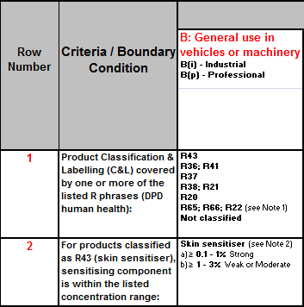
Step 1a:
Is the product classified for human
health?
Yes - classified as R20
From Document 4 (Health Boundary Conditions Matrix) under Use Group B check:
  Row 1: if R20 is included in Row 1
  Row 2: Is the product a sensitiser?
  No, therefore sensitiser concentrations in Row 2 do not apply
Conclusion: GES for Use Group B applies
☑
☑
21/11/13 ATIEL/ATC Generic Exposure Scenario Approach

Slide 29
21/11/13 ATIEL/ATC Generic Exposure Scenario Approach

Slide 30
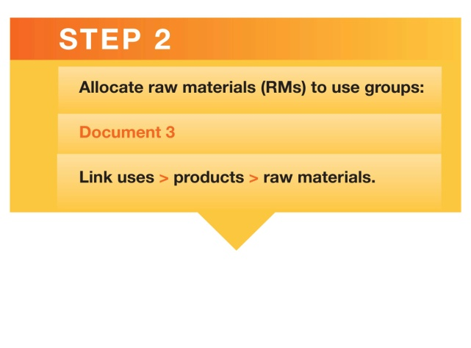
Verification check
Verify incoming raw material Exposure Scenario against the GES
Map all raw materials to the ATIEL/ATC
use groups (Document 3)
Link uses to products to raw materials
In this example, all components of the ‘Synthetic Hydraulic Oil’ should be mapped to ‘Use Group B (industrial)’
  Component 1: Dec-1-ene, dimers, hydrogenated
  Component 2: Tris(methylphenyl) phosphate
  Component 3: n-phenyl-1-naphthylamine
21/11/13 ATIEL/ATC Generic Exposure Scenario Approach

Slide 31
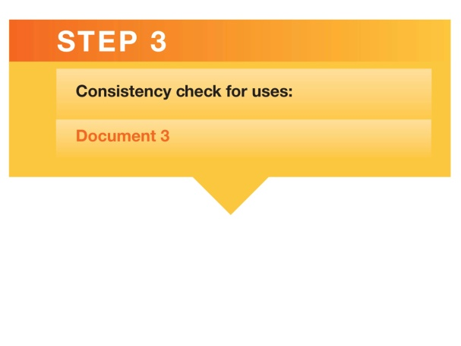
Verification check
Received a REACH SDS with Exposure Scenarios for component 3 – n-phenyl-1-naphthylamine (R22, R48/22, R43; R50/53)
Use check against incoming SDS:
  SDS Section 1.2: Additive for lubricants ☑
  Exposure Scenario: ES2 General industrial use
    PC17 Hydraulic fluids, PC24: Lubricants, greases, release products ☑
    PROCs: 1, 2, 8a, 8b, 9 ☑
    ERC4 and ERC7 ☑
SDS includes ES relevant to Use Group B(i)
21/11/13 ATIEL/ATC Generic Exposure Scenario Approach

Slide 32

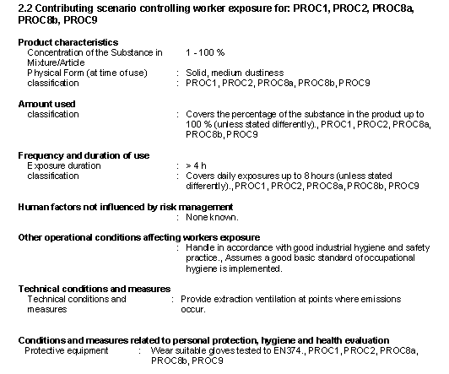
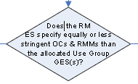
Verification check
☑
☑
☑
☒
NO
☑
21/11/13 ATIEL/ATC Generic Exposure Scenario Approach

Slide 33
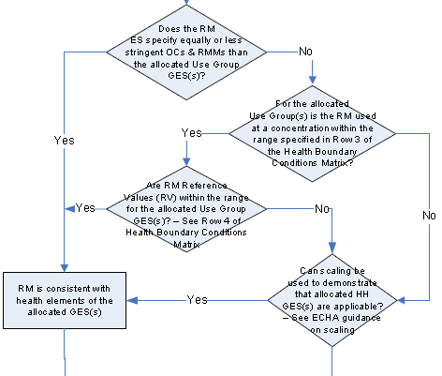

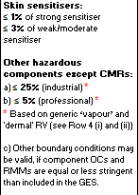
Verification check
From Document 4:
☑
21/11/13 ATIEL/ATC Generic Exposure Scenario Approach

Slide 34


Verification check
From Document 4:
Raw material DNELs:
☒
Raw material VP:
☑
21/11/13 ATIEL/ATC Generic Exposure Scenario Approach

Slide 35
Verification check
If the outcome was No:
Apply scaling:
ECETOC TRA model applied by supplier
Actual concentration in Product: <1% = 90% exposure reduction
Replaces LEV with 90%
exposure reduction
If elevated temperature,
GES indicates LEV is required
☑
☑
21/11/13 ATIEL/ATC Generic Exposure Scenario Approach

Slide 36
Example 2
Environmental GES
Compilation of environmental GES for example 2 –hydraulic fluid
Process overview
Identify which component in formulation drives risk for environment
Look up relevant Operating Conditions (OCs) for that component from prepared tables
Insert values into GES template
Verify GES by comparison with details found in Raw Material ES
21/11/13 ATIEL/ATC Generic Exposure Scenario Approach

Slide 37

Example 2 RDS
Identification of potential risk
determining substances (RDS)
Based on concentration and classification there are 2 potential RDSs in product:
Both substances are listed in Document 6 Environmental Classified Substance Table:
Note RDS codes (GES 8.2 and 2.2 for this example)
21/11/13 ATIEL/ATC Generic Exposure Scenario Approach

Slide 38
Determine RDS for
formulation
Look up Msafe values for RDS code x Use in
’Document 7- GES values table’:
  Eg. n-phenyl-1-naphthylamine code 2.2:
Adjust Msafe _{100%} _{product} to Msafe _{max. formulation} _{conc.}
Lowest Msafe_{formulation} is RDS for that product
21/11/13 ATIEL/ATC Generic Exposure Scenario Approach

Slide 39
Operating conditions
RDS/Use
To compile GES – look up following values from Document 7 - ‘GES Values Table’
  EU tonnage
  Msafe (as in previous step)
  Release fraction to water (scale to concentration)
  Removal efficiency in sewage treatment
  eg...
21/11/13 ATIEL/ATC Generic Exposure Scenario Approach

Slide 40
GES Template
Insert values from look-up tables
into use group ‘Bi’ GES template
‘RED’ values are from tables
Other values are pre-filled on template for this Use
21/11/13 ATIEL/ATC Generic Exposure Scenario Approach

Slide 41

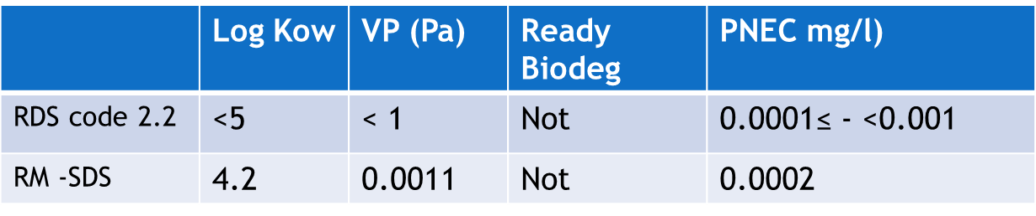
Verification of GES with
Raw Material ES
Check: Log Kow, vapour pressure, biodegradability and PNEC and on Raw Material (RM) SDS are consistent with RDS Table
CONCLUSION
The RDS code selected for GES is consistent with properties of RM
21/11/13 ATIEL/ATC Generic Exposure Scenario Approach

Slide 42
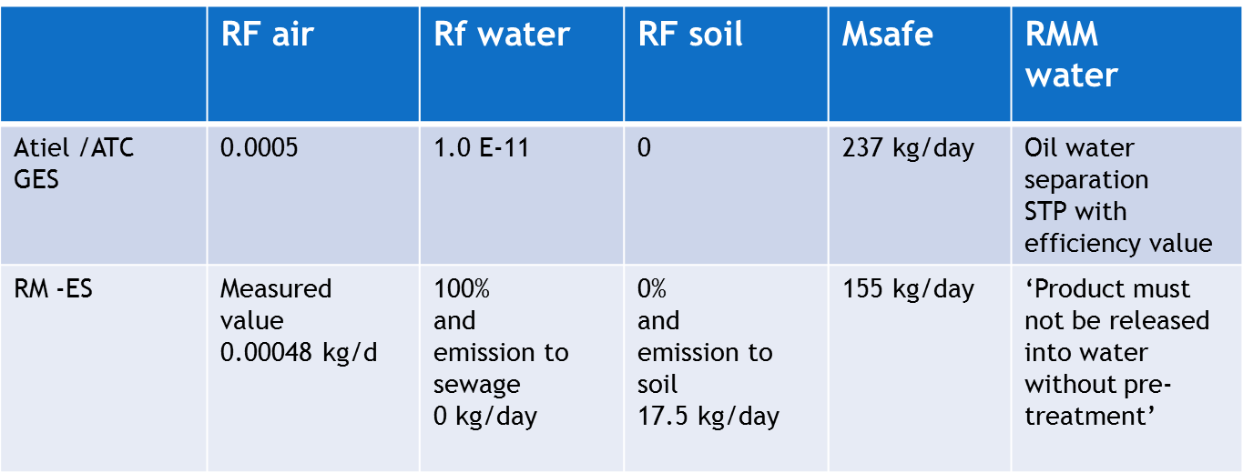
Verification of GES with
Raw Material ES
Comparison of OCs and RMMs
CONCLUSION
The RDS code selected for GES is consistent with properties of RM
CONCLUSION:
Difficult to interpret RM –ES. Conflicting values for releases
Direct comparison between RM-ES and Atiel /ATC GES is challenging
21/11/13 ATIEL/ATC Generic Exposure Scenario Approach

Slide 43
Conclusions and Discussion
Safe use information for mixtures.
ATIEL-ATC GES Approach
21/11/13 ATIEL/ATC Generic Exposure Scenario Approach

Slide 44
Frequently Asked
Questions (FAQ)
There are FAQs available on the ATIEL website which cover the GES approach. Guidance and all the documents previously mentioned are also available on the ATIEL website. Some additional FAQs may be as below:
How much level of expertise will I need to apply this approach?
  A person who is competent to author regular SDS should be able to apply this approach. Positive feedback received from lubricants formulators outside the core group. Awaiting further response before deciding on extent of additional training material.
How long does it take to apply this approach?
  Once the background documents have been read and understood the GES approach is straightforward to apply. More challenging is the verification of the GES against incoming raw material ES as quality of incoming information is variable.
21/11/13 ATIEL/ATC Generic Exposure Scenario Approach

Slide 45
Frequently Asked
Questions (FAQ)
What languages are the GES available in?
  The GES are available in English only, however the vast majority of the phrases used are available in the ESCom library. Specific phrases which were not in the ESCom phrase library have been translated by ATIEL/ATC.
Is this process able to be automated by computer?
  There are IT implications with automating the process but some
  companies are automating the process so it can be done.
21/11/13 ATIEL/ATC Generic Exposure Scenario Approach

Slide 46
Minimum Input
Required
The GES approach can be applied without much data needed up front.
Human health – hazard classification.
Environment:
  PNECfw(aq)
  Log Kow
  Vapour pressure
  Biodegradability
These are provided by ATIEL/ATC for a large number of the typical Risk Determining Substances (RDS).
21/11/13 ATIEL/ATC Generic Exposure Scenario Approach

Slide 47
Advantages
Advantages of GES approach:
Delivers clear, concise, consistent advice to downstream users from all lubricant’s suppliers.
Constrains the length of the e-SDS annex to a manageable size.
GESs are inherently conservative but not unrealistic.
Unnecessary to have all the information available for the incoming raw materials to generate the GES.
CMR and respiratory substances are outside the boundary of the HH GES approach which limits applying generic information to products which are highly hazardous.
21/11/13 ATIEL/ATC Generic Exposure Scenario Approach

Slide 48
Practical Issues
Practical Issues of GES Approach:
Need to define the conditions of safe use for a large number of components that have a wide range of hazard and physical-chemical properties. There will therefore be some mixtures that the GES approach will not ‘fit’.
  However we believe it covers the vast majority.
It was designed for ATIEL/ATC sector so the content may not be suitable for other sectors.
Other sectors with more complex supply chains may find
the develop of GES inappropriate.
21/11/13 ATIEL/ATC Generic Exposure Scenario Approach

Slide 49
Questions
Discussion
Now we have explained the ATIEL-ATC approach and demonstrated our example formulations are there any questions that have not already been addressed?
?
Thank you for your participation
21/11/13 ATIEL/ATC Generic Exposure Scenario Approach

